Slide 1
Deep Learning for Beginners
Theory and application

Slide 2
A Brief History
Prior to 2000s
The first true neural network model was created by Rosenblatt called the Perceptron
Following years of progress, in 1969 Marvin Minsky and Seymour Papert released a book called “Perceptrons” with proofs that stuttered progress in neural nets and catalyzed the first AI Winter
In 1975, Rumelhart et al. showed that a multilayer perceptron can solve the exclusive-or(XOR) problem, something which Minsky proved was impossible for a single layer network. This was via Backpropagation
The 80s introduced multiple new, simpler algorithms(SVMs, Random Forests). Their success led to another downturn in ANN research

Slide 3
A Brief History(Cont.)
2000s - Present
Following the AI Winter of the 80s and early 90s, the 2000s saw a renewal in AI funding generally
After it’s discovery in 1997, the LSTM became competitive with classic algorithms on the task of speech recognition in the early 2000s
In 2008-2009, the benefit of using GPUs was discovered, leading to improved training times on the order of magnitudes
2012 saw 2 very important improvements: First, Andrew Ng and team used unsupervised deep networks to classify high-level features like cats from youtube videos. In the same year, Krishevsky et al. created a regularization method known as dropout, which won them the imagenet 2012 challenge by an extremely large margin
Post 2012: ADAM optimizer, AlphaGo/AlphaZero, Capsule Networks, GANs

Slide 4
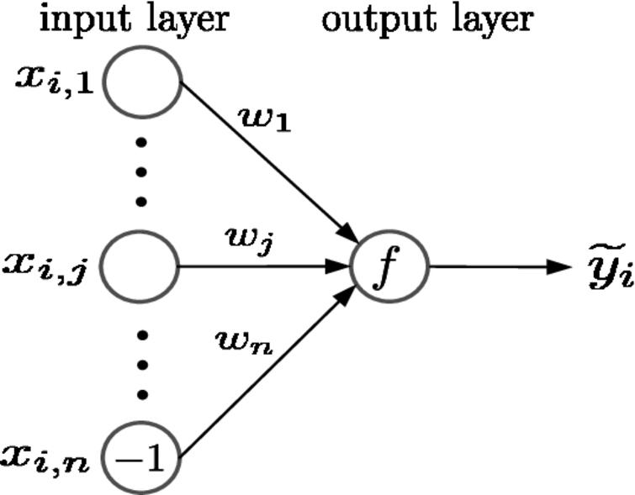
Breaking Down an ANN
What is a neural network?
A neural network is a connectionist model that roughly models human neuronal connections. ANNs are a type of function approximator
Simple one layer perceptron, the simplest network

Slide 5
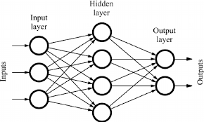
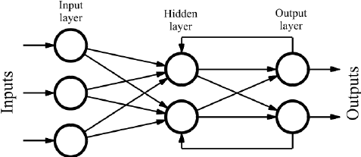
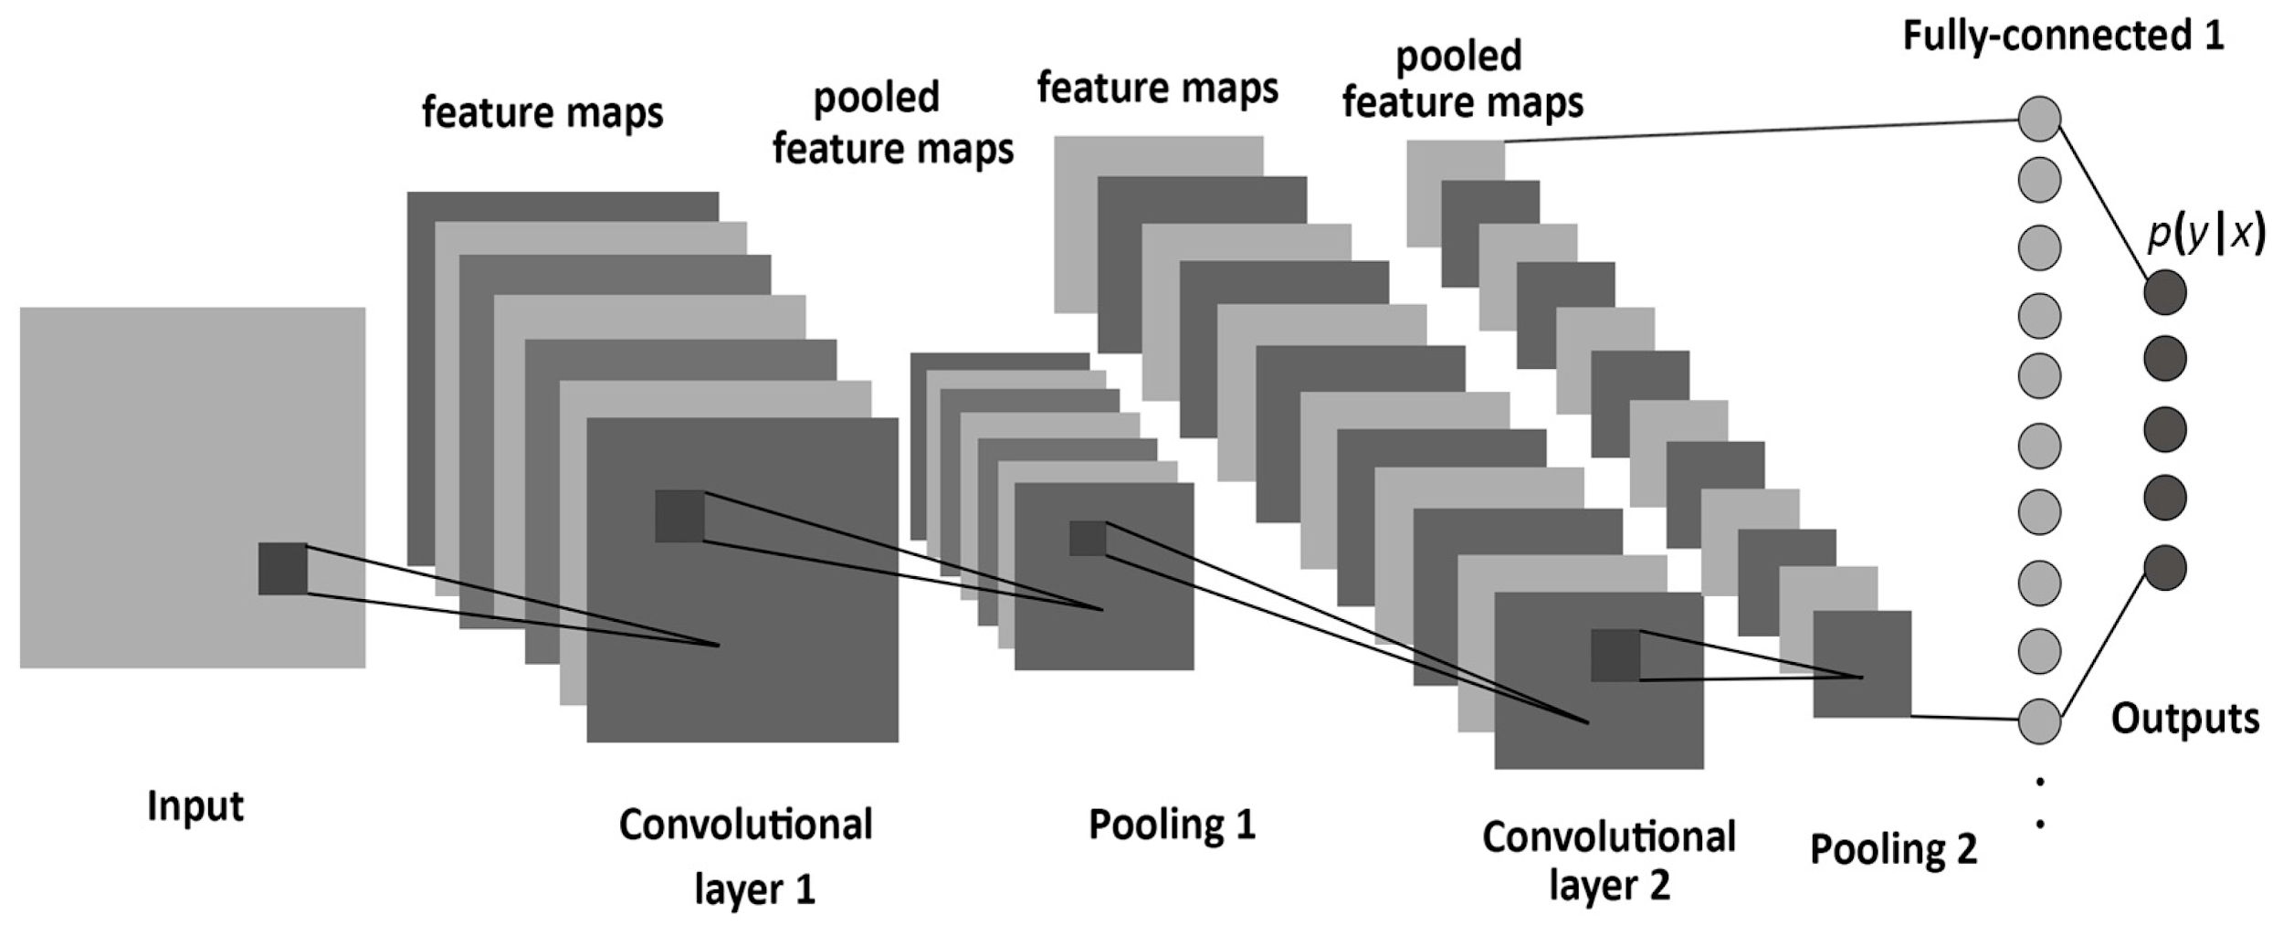
Types of networks
Feed-Forward
Recurrent Networks
Convolutional NN
The main class of network used in NLP. Also have application in problems like time series prediction
One of the simpler networks, used in everything from regression to classification
Neural network with convolutional layers connected to hidden layers, primarily used in computer vision

Slide 6
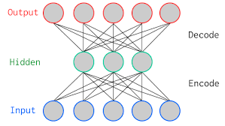
Types of networks(Cont.)
Autoencoder
GANs(Generative adversarial network) models consist of 2 networks. A generator and a discriminator. The generator, generates data that fools the discriminator
GANs
Markov Chain
Autoencoders are type of network normally used to learn a compressed representation of the data, commonly used in problems like anomaly detection and denoising
A old type of network(graph) used to model a dynamic system where each node is a probability.

Slide 7
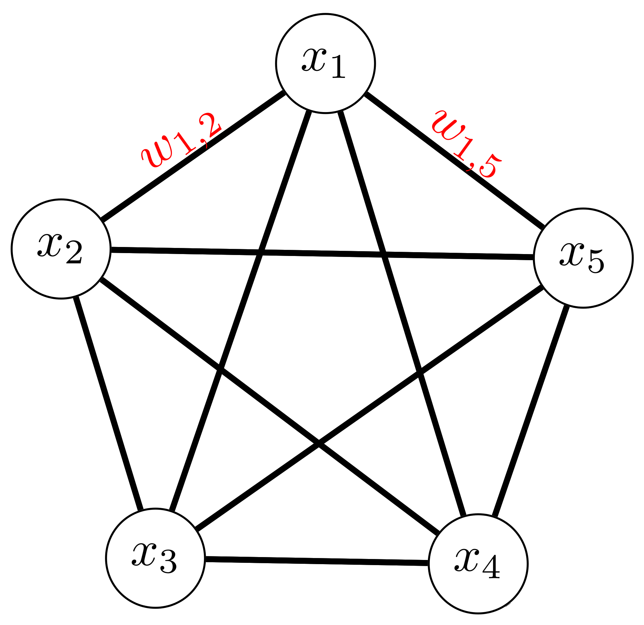
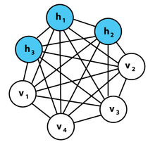
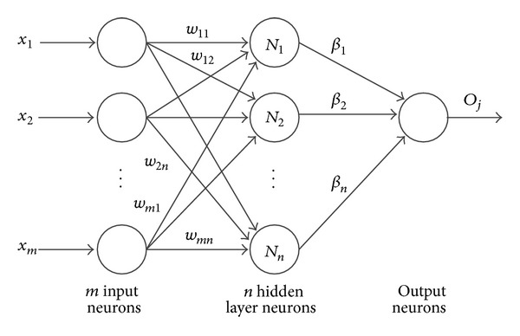
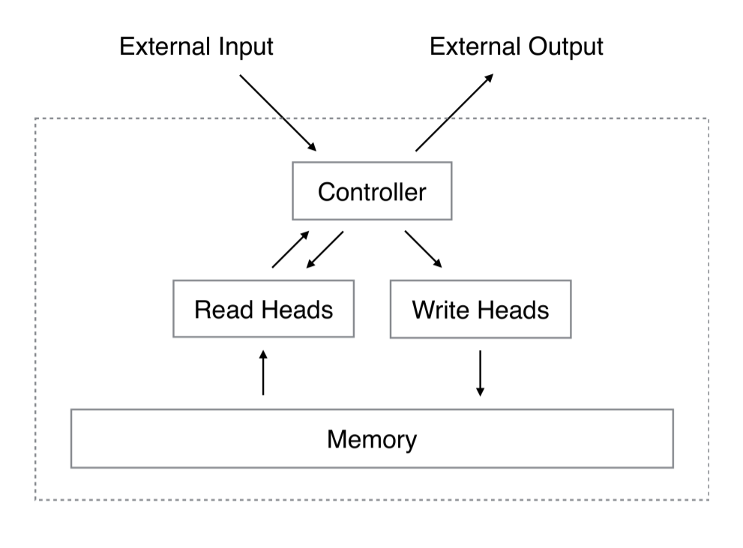
Other architectures
Hopfield Network Boltzmann Machine Extreme Learning Machine Neural Turing
Machine

Slide 8
Starting simple
Structure of a network
At a high level a neural network consists of a few different components:
Input Layer
Hidden Layers
Output Layer
Activation functions
Optimization algorithms
Loss or Cost Functions
Regularization

Slide 9
Input Layer
The input layer is the first layer of any network and there in only one(for all known models)
The input layer will have the dimensionality of your data(i.e 42 columns = input dim of 42(or units), similarly for CV (3,256,256).
One important note, when using keras this layer is implicit and defined by input_dim or input_shape
The input layer does not perform any function on the data

Slide 10
Hidden Layer
A hidden layer is a layer sandwiched between the input and output layers. Typically, these will be fully connected but in certain models the hidden layers can be sparsely connected.
The hidden layers are where the concept of the “black box” equivalency for neural networks originate. While it is fairly simple to discern what's happening at the input and output layers, what the neural network learns in its hidden layers can be difficult to derive.
Normally all hidden layers will use the same activation function however there are cases where this is not true
The “deep” in deep learning is networks with a large number of HL

Slide 11
Output Layer
The layer that makes the prediction(class, regression value, etc)
Layer will normally have a sigmoid or softmax activation for classification, and linear for regression
We can consider the hypothesis(output) of a neural network to be the following(with a bias unit):

Slide 12
Activation Functions
What is an activation function?
An activation function is what determines the output of any particular node(or unit/neuron)
The activation function is analogous to the rate of action potential(firing) of mammalian neurons
In the second equation from the last slide(shown below) the function of the network parameters is our activation

Slide 13
Types of activation functions
Linear vs Nonlinear
Linear activation functions are(obviously) linear, meaning they are lines(as opposed to curves or some other geometric structure). Due to the nature of this simplicity linear activation function struggle to solve complex problems when used exclusively. A NN with solely linear activations is comparable to linear regression
Nonlinear activation functions are nonlinear. This nonlinearity is key to solving complex problems. Naturally, this is because nonlinearity allows for more complexity to be learned as the learned correlations due not linear. Thus, they can model non-linear problems.

Slide 14
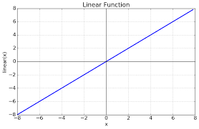
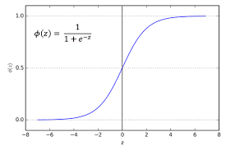
Examples of Activations
Linear
Sigmoid
Softmax
Common nonlinear activation function that was used in hidden layers for many years. Mainly used in binary classification(equivalent to softmax with 2 units)
The simplest activation function. Used as output activation in regression and reinforcement learning.
Another common nonlinear activation used as the activation function of the output layer in multiclass classification problems which then outputs a class probability matrix(or action-value probabilities in RL). A generalization of the sigmoid.

Slide 15
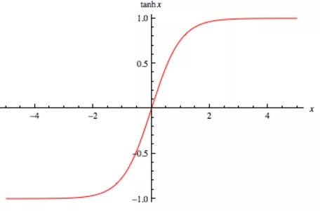
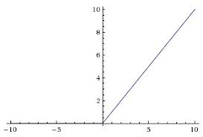
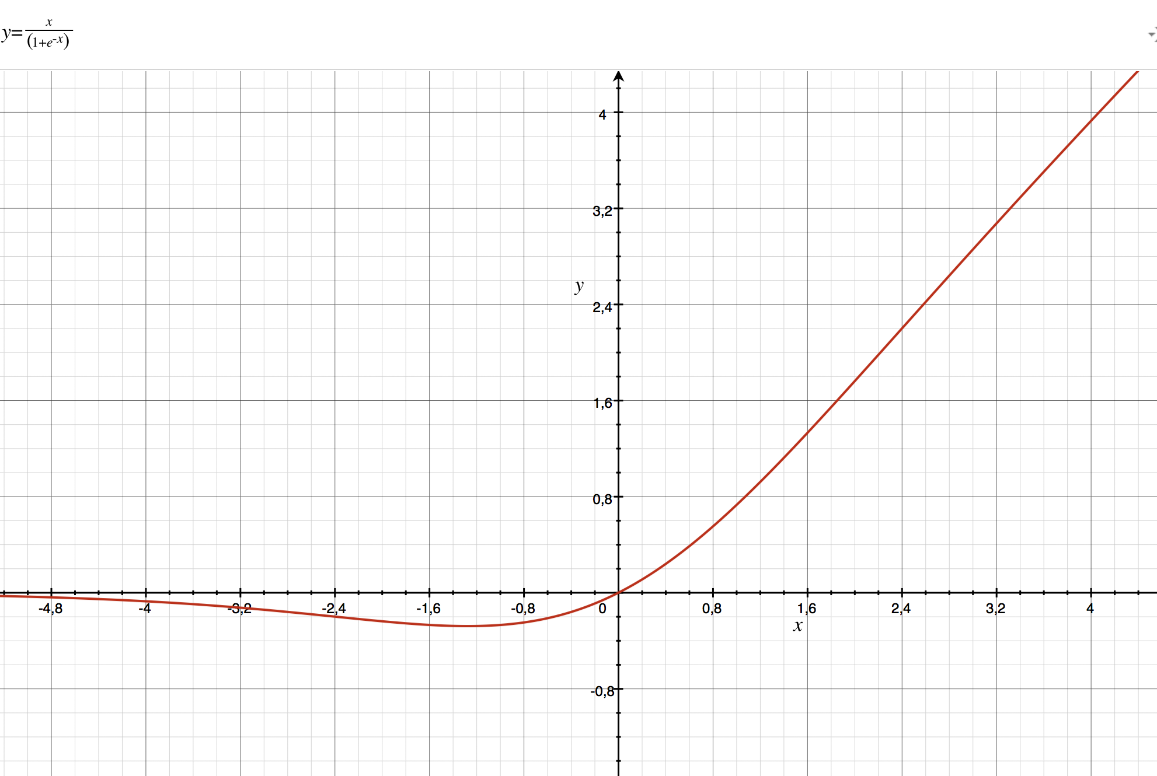
Examples of Activations(cont.)
Tanh
ReLU
Swish
Fairly recent algorithm defined as f(x) = max(0,x). While at first it may not look it, it is inherently nonlinear and became popular due to the vanishing gradient problem.
Commonplace activation function that has fallen out of favor after the discovery of the ReLU
Defined as f(x) = sigmoid(x)*x. This function is beginning to see wide adoption and better than ReLU in a variety of use cases, and problem domains.

Slide 16


Other activations
GELU
Softplus
ELU
Binary-step
Activation discovered at the end of last year, performs better than ReLU in a variety of problems.
A rectifier that is essentially a smooth ReLU. Similar performance as well,
Powerful rectifier activation function which tries. Has interesting properties that speed up learning and perform better than ReLU on many tasks.
Older activation function that can be useful on binary classification.

Slide 17
Optimization
What is an optimization algorithm?
Optimization is the process by which a neural network computes its weights. However, optimization is a much more general mathematical concept. In general, it is the process of updating an underlying function toward some ground truth(perhaps attempting), or optimal solution.
Backpropagation
Backprop is one of the most important concepts in ML. It is by far the most prominent way to compute the gradients of the network when calculating the weights(via optimization algos.)

Slide 18
Optimization
What is an optimization algorithm?
Optimization is the process by which a neural network computes its weights. However, optimization is a much more general mathematical concept. In general, it is the process of updating an underlying function toward some ground truth(perhaps attempting), or optimal solution.
Backpropagation
Backprop is one of the most important concepts in ML. It is by far the most prominent way to compute the gradients of the loss function when calculating the weights(via optimization algos.). For example, in SGD, Backprop calculates the gradient of steepest descent. It will also be the subject of the challenge question near the end.

Slide 19
Some Optimization Examples
Stochastic Gradient Descent
ADAM
RMSprop
ADAM is an extremely popular optimization method. It is adaptive, meaning the learning rate adjusts based on some params. Importantly, recent papers have shown inferior convergence properties when compared to vanilla SGD.
One of the first algorithms to be used in ANN optimization and still is arguably the most popular. The stochasticity(randomness) is due to models randomly sampling over the dataset
This algorithm went out of style as fast as it become somewhat popular. Hinton’s algorithm, originally proposed ad hoc in a lecture, was quickly overtaken by ADAM when it’s superior efficiency and convergence properties came to be known.

Slide 20
Loss/Cost Functions
What is an loss function?
A loss function computes the cost(analogous) to the error rate related to an output prediction or “event”. This is what our optimization algorithm is trying to minimize. A cost function is the inverse of a utility or reward function(mainly used in reinforcement learning). There are quite a few different types of loss functions(Bayesian, frequentist, regret). One thing to keep in mind is loss funcs are much more specific than activation functions in HL, so you must choose the correct one that fits your problem.

Slide 21
Loss/Cost Functions(Cont.)
Examples and usage
As initially explained, one must select a loss function that plays well with problem class. For example, one would use categorical or binary crossentropy for a classification problem while if performing regression we would use something like mean squared error or mean squared logarithmic error. Logcosh for example, has some very interesting properties that allow it to act like MSE but not be subject to wild swings in gradient updates due to incorrect predictions.
Other examples:
Focal Loss - Classification
MAE - Mean Absolute Error - Regression

Slide 22
Regularization
What is regularization?
R
In general, regularization in the process of changing a model in some way to improve generalization, and thereby, real-world accuracy. Normally, this is done by way of reducing model complexity or learned parameters, however there are other methods.
For the most part, these methods are applied directly to the weight matrix or units themselves.

Slide 23


Regularizers(Cont.)
Dropout
L2
L1
L2 regularization is likely just as popular as dropout in ANNs. Here instead of dropping out some portion of neurons randomly, we apply a weight decay to the weight matrix.
This method of regularization randomly turns off a proportion of units in a layer. While counterintuitive, this forces data through different paths in the network and forces network to be “smarter” in it’s updates
L1 is very similar to L2 except that we are taking the absolute value of the summed weight matrix as opposed to the squared sum. It is useful in problems with sparse feature sets.

Slide 24
Conclusion and challenge
What did we do ?
In this lesson, we went through the history of deep learning as a subject and the structure of a neural network. Additionally we went over the components therein with some detail.
Challenge Question
This challenge comes straight from one of the top minds in AI currently, Andrej Karpathy. Read up on backpropagation, once you feel you have a reasonable handle on it, try to implement the forward and back passes from scratch in numpy. You can check the answer and get more context here: https://medium.com/@karpathy/yes-you-should-understand-backprop-e2f06eab496b

